Slide 1
Data Visualisation using ggplot2

Slide 2
How it works
Two options of working with the package
Easy – using qplot() (=quick plot)
Complicated – using ggplot

Slide 3
qplot
Basically very similar to the function plot() in R
The first two arguments to qplot() are x and y
An optional data argument (recommended)
Exp: qplot(x, y, data = mydata)

Slide 4
qplot
You can change color, size, shape and transparency (all of this is called aesthetics)
This can either be set to the default aesthetics or manually using the function I().
You can decide on the type of the plot (scatterplot, box-plot, histogram) by using “geom” function.

Slide 5
ggplot - How it works
A plot is made up of multiple layers.
A layer consists of data, a set of
mappings between variables and
aesthetics, a geometric object and a
statistical transformation.
Scales control the details of the mapping.
All components are independent and
reusable.

Slide 6
Anatomy of a plot
Data – the data name that you want to present
Aesthetics – the visualization of the plot
Geom – geometric objects. Represent what you see in the plot: points, lines, polygon etc.
Themes – control presentation of non-data elements
Stat – statistical transformations
Scale – intersect between the data and the aesthetics.
Coord – coordinate system. describes how data coordinates are mapped to the plane of the graphic.
Position adjustments
Facet - describes how to break up the data into subsets and how to display those subsets as small multiples.

Slide 7
Data
In ggplot2, we always explicitly specify the data
ggplot(data=mpg, aes(x=cty, y=hwy))
+ geom_point()

Slide 8
Aesthetic Mapping
In ggplot land aesthetic means "something you can see“
Includes:
Position (i.e., on the x and y axes)
Color ("outside" color)
Fill ("inside" color)
Shape (of points)
Line type
Size
Aesthetic mappings are set with the aes() function

Slide 9

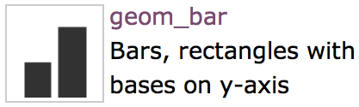
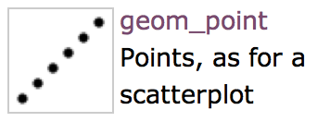
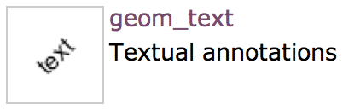
Geometric Object
A geom can only display certain aesthetics
A plot must have at least one geom; there is no upper limit

Slide 10
ggplot
Creating a plot
Adding data
Mapping aesthetics
Exp: p <- ggplot(diamonds, aes(carat, price, colour = cut))
Adding layers*
Exp: p <- p + layer(geom = "point")

Slide 11
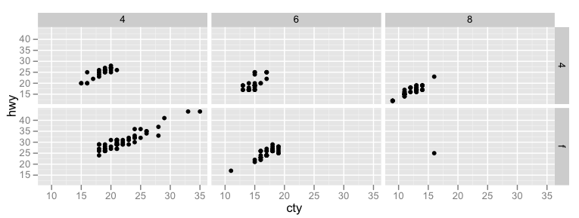
Faceting
Lay out multiple plots on a page
Split data into subsets
Plot subsets into different panels

Slide 12
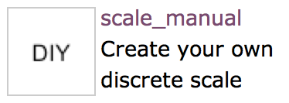
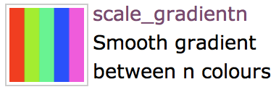
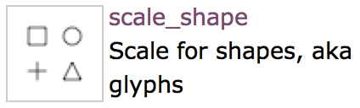
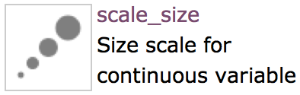
Scales
Control mapping from data to aesthetic attributes
One scale per aesthetic

Slide 13
Faceting
Faceting is ggplot2 parlance for small multiples
The idea is to create separate graphs for subsets of data
ggplot2 offers two functions for creating small multiples:
facet_wrap(): define subsets as the levels of a single grouping variable
facet_grid(): define subsets as the crossing of two grouping variables
Facilitates comparison among plots, not just of geoms within a plot

Slide 14
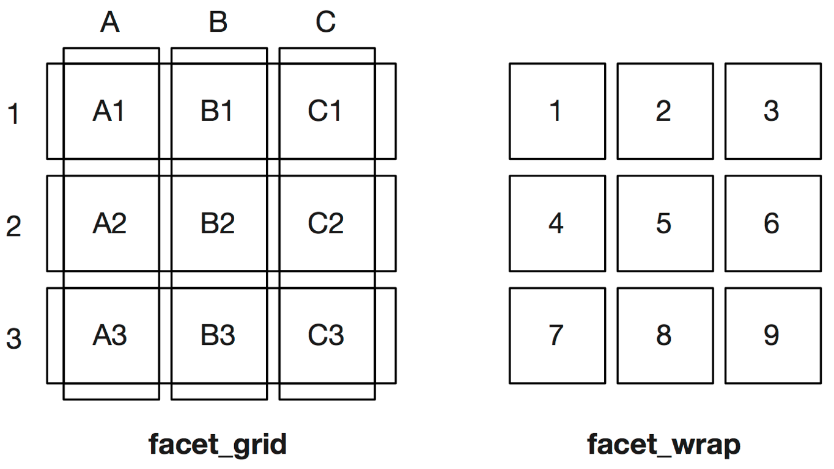
Facet Types
1D ribbon of panels wrapped into 2D:
2D grid of panels:

Slide 15
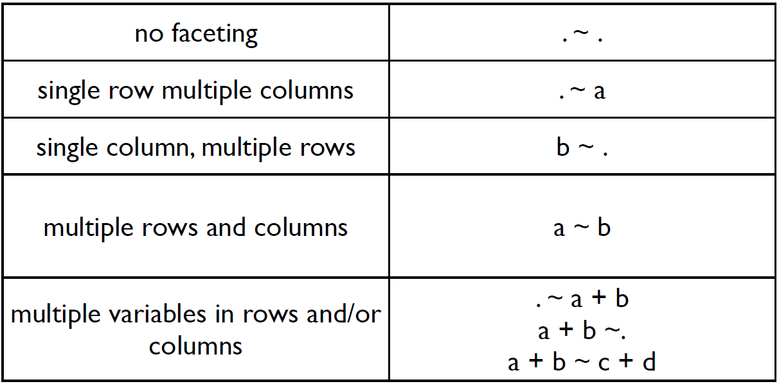
Faceting Formula

Slide 16
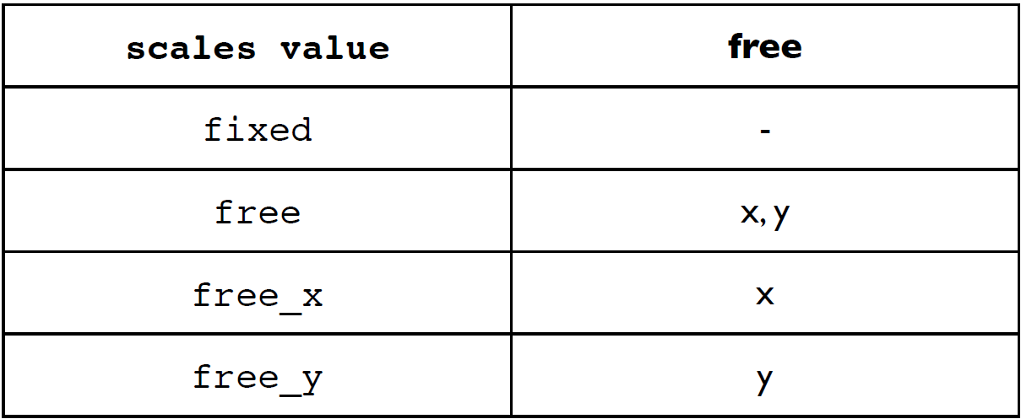
Scales in Facets

Slide 17
Themes
The ggplot2 theme system handles non-data plot elements such as
Axis labels
Plot background
Facet label background
Legend appearance
Specific theme elements can be overridden using theme()

Slide 18
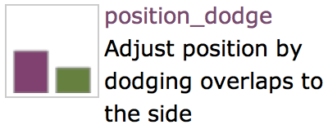
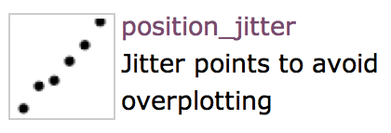
Position adjustments
Tweak positioning of geometric objects
Avoid overlaps

Slide 19
Statistical Transformations
Each geom has a default statistic, but these can be changed
Some plot types (such as scatterplots) do not require transformations–each point is plotted at x and y coordinates equal to the original value
Other plots, such as boxplots, histograms, prediction lines etc. require statistical transformations

Slide 20
Exp: position_jitter
Avoid overplotting by jittering points
ggplot(overplotted, aes(x,y)) +
geom_point(position=position_jitter
(w=0.1, h=0.1))

